Slide 1


Slide 2
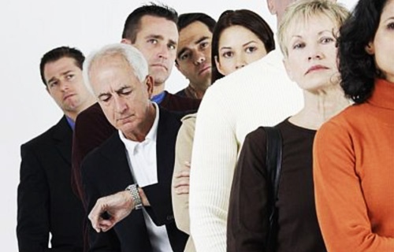
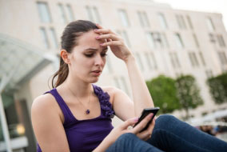
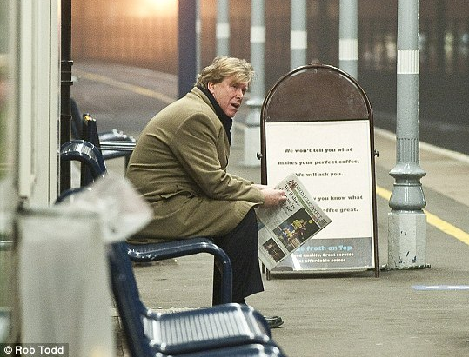
Actual Problems

Slide 3

We Are Saving Your Time
With our application the communication of citizens and smart city services will be fast and comfortable.

Slide 4

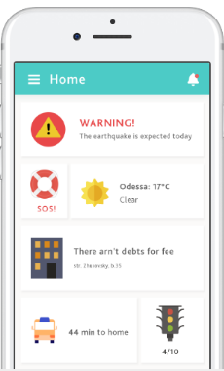
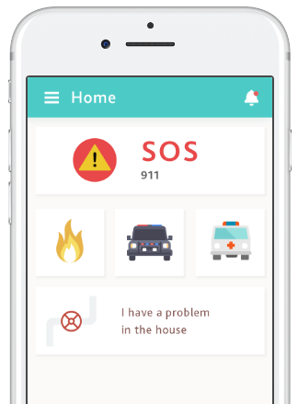
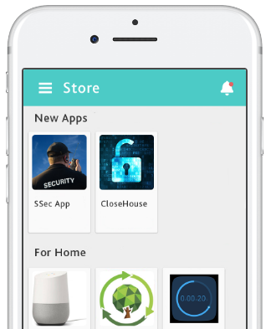

Slide 5
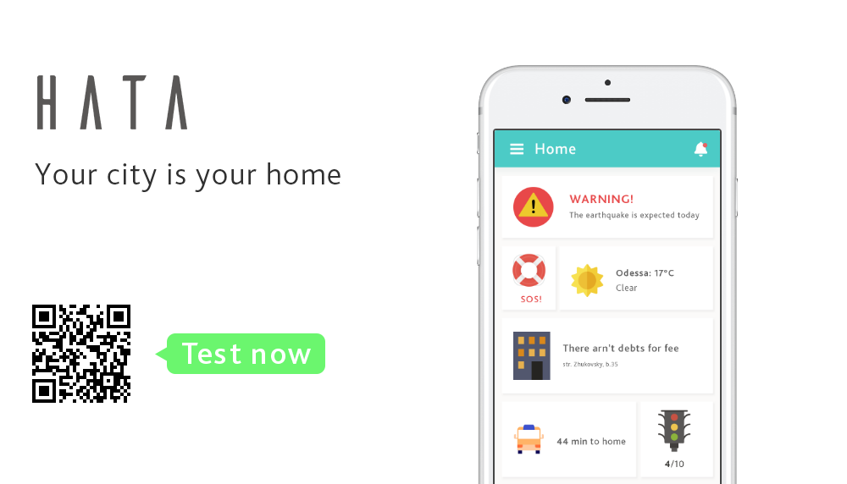

Slide 6
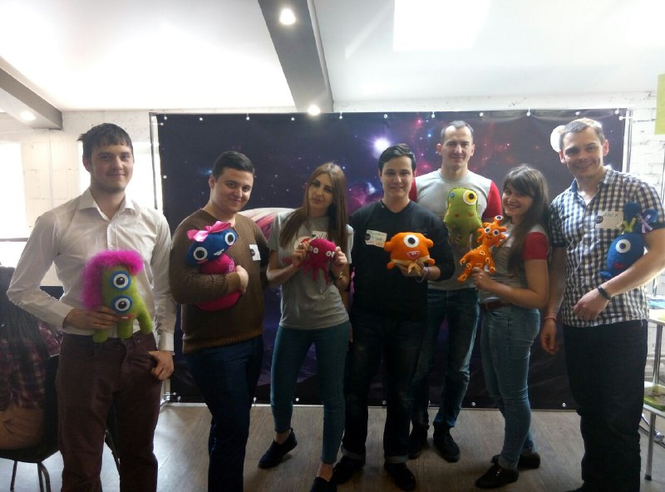
What We Have Already Done?
Worked out the concept of modern city
Wrote down application documentation
Created a demonstration prototype app

Slide 7
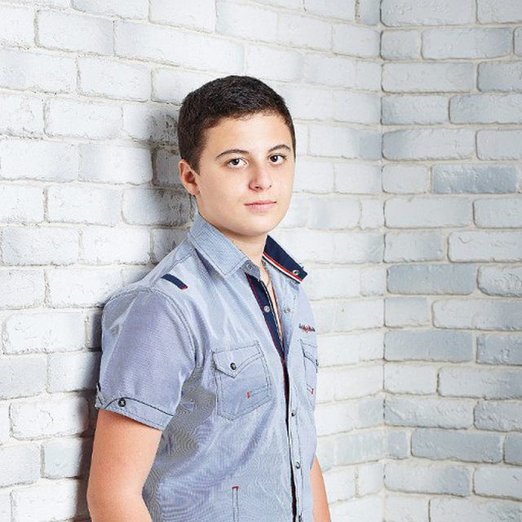

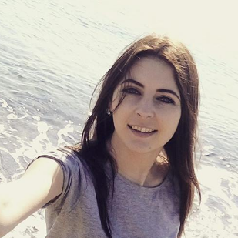
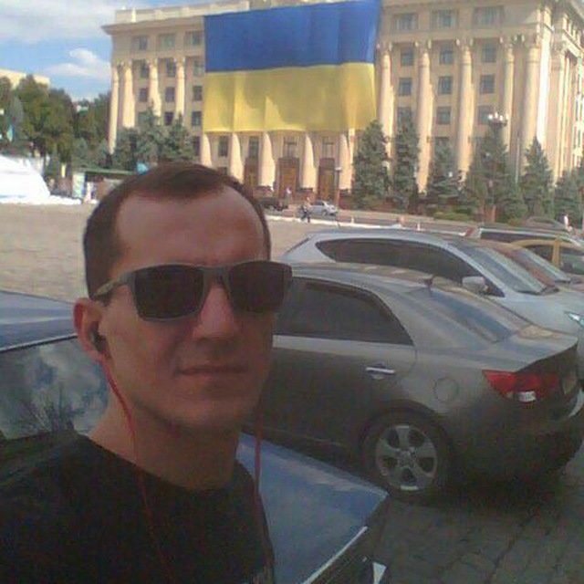
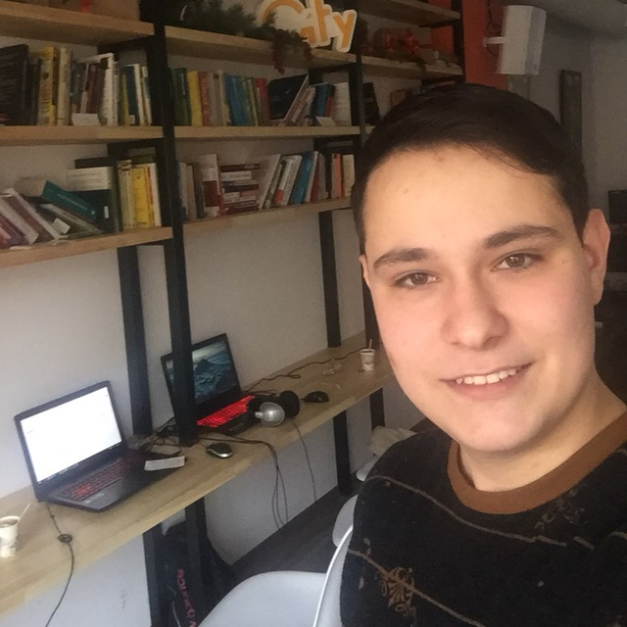
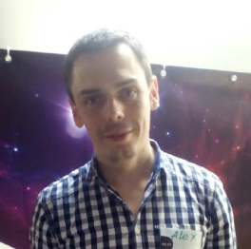
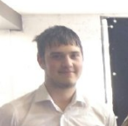
Designer
(oh, really?)
Blogger
Critic
Leader
The guy who wrote the docs
Speaker
Funky Marketer
Notes:
y

Slide 8
Contact Us:
Viktoria Babenko - ajvi@mail.ua
Marta Andriychak- mbolubash@gmail.com
Dmitriy Ulisov - oligarhiya@gmail.com
Alexandr Pintyak- apintyak@gmail.com
Konstantin Shevchuk - kis.shevchuk@gmail.com
Viktor Nersesov- 1vitiok1@gmail.com
Alexandr Sokolkov - osokolkov@gmail.com
Аlexandr Makoveckiy
Hata on NASA and Github.

